Slide 1
IoT with MIT App Inventor
Fundamental
Xincheng Tang

Slide 2
What is IoT?
Bring computing off the screen and into the world of everyday things!
The Internet of Things (IoT) refers to interfaces between everyday objects and the Internet, opening up a universe of new applications, smarter devices, and wider opportunities. With MIT App Inventor IoT, you can enter this universe as a creator, not just a consumer, even if you’ve never programmed before.

Slide 3
What you can do?
You can develop IoT applications the same way you develop any other MIT App Inventor mobile apps. Now you can program devices, sensors, appliances, instruments, robots— anything that can be connected. Not only that, you can incorporate smartphone capabilities into your IoT creations.
If you build an app that turns a light on and off, you can make the light respond to voice commands.
If you build a heart monitor, you can store the results on the Web or email them to trainers.
If you program a mobile robot, you can add geolocation to the robot’s sensing abilities.
And many more…

Slide 4
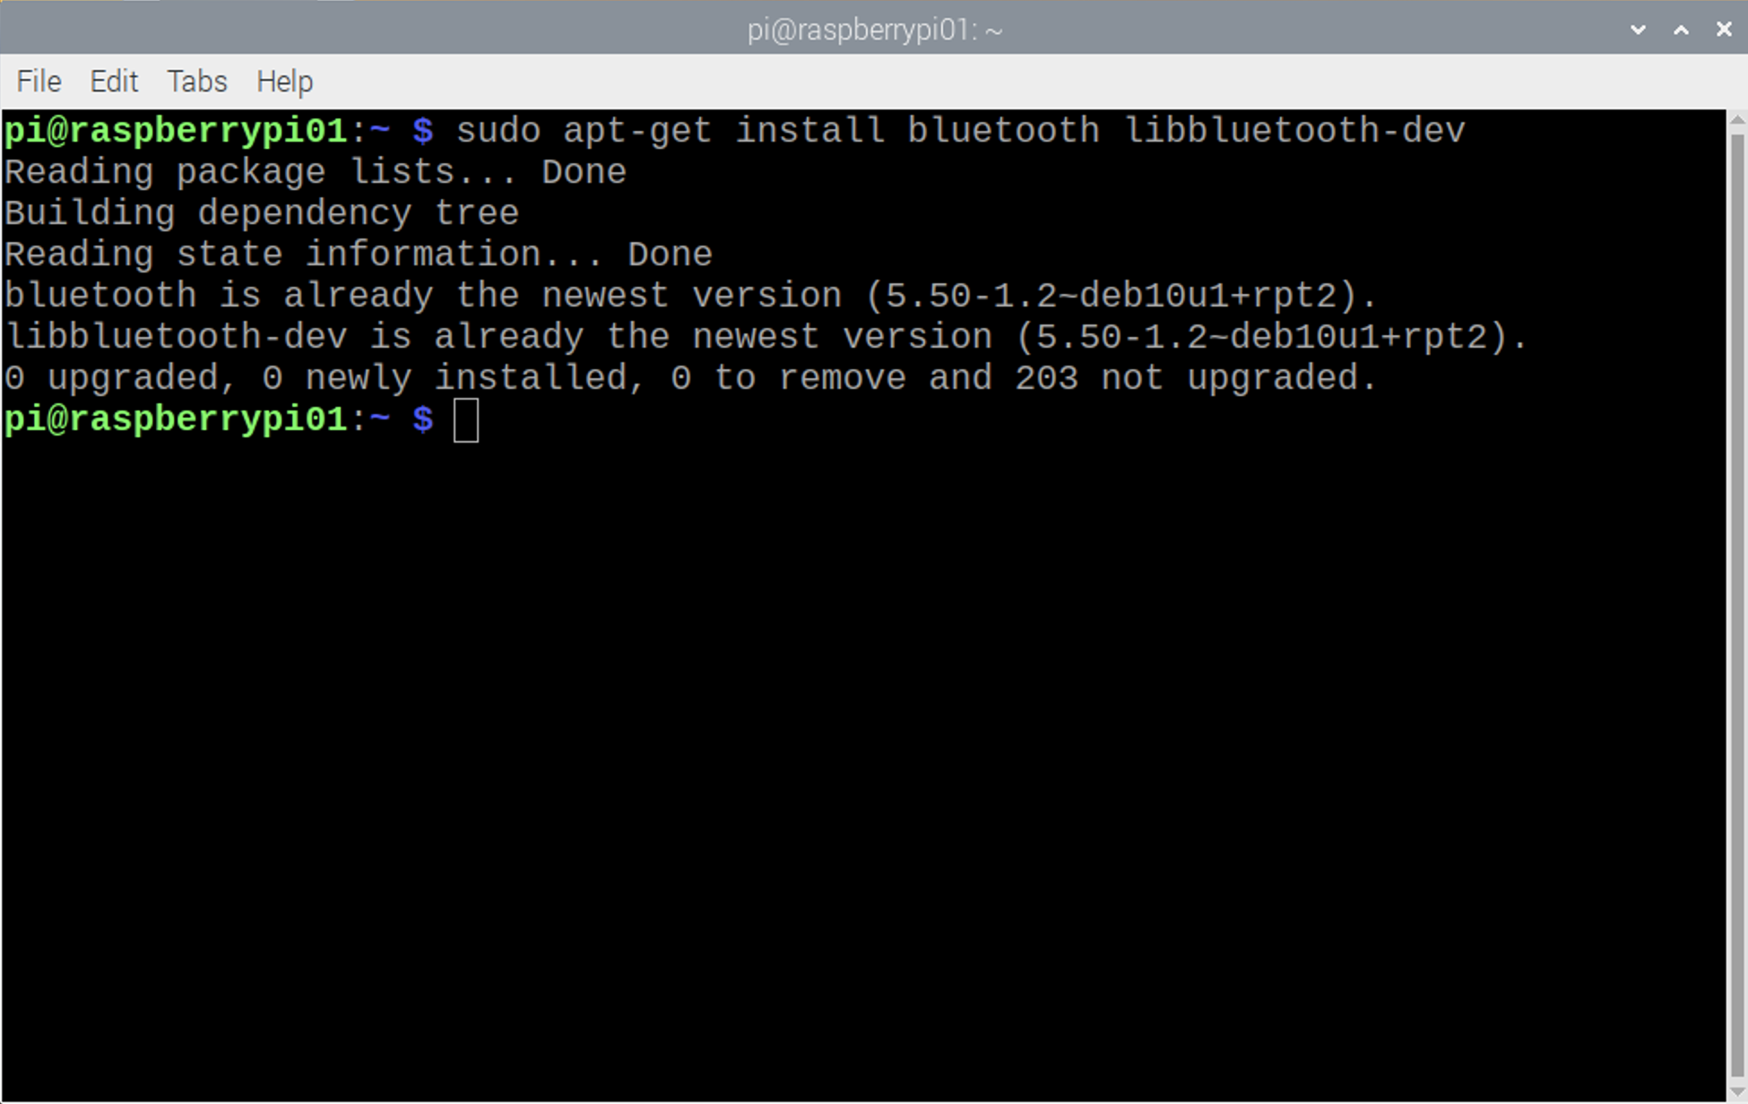
Python Program - Bluetooth setup
$ sudo apt-get install bluetooth libbluetooth-dev

Slide 5
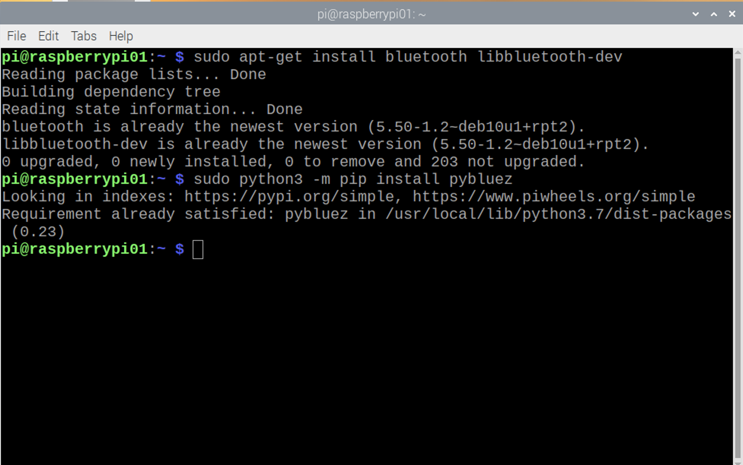
Python Program - Bluetooth setup
$ sudo python3 -m pip install pybluez

Slide 6
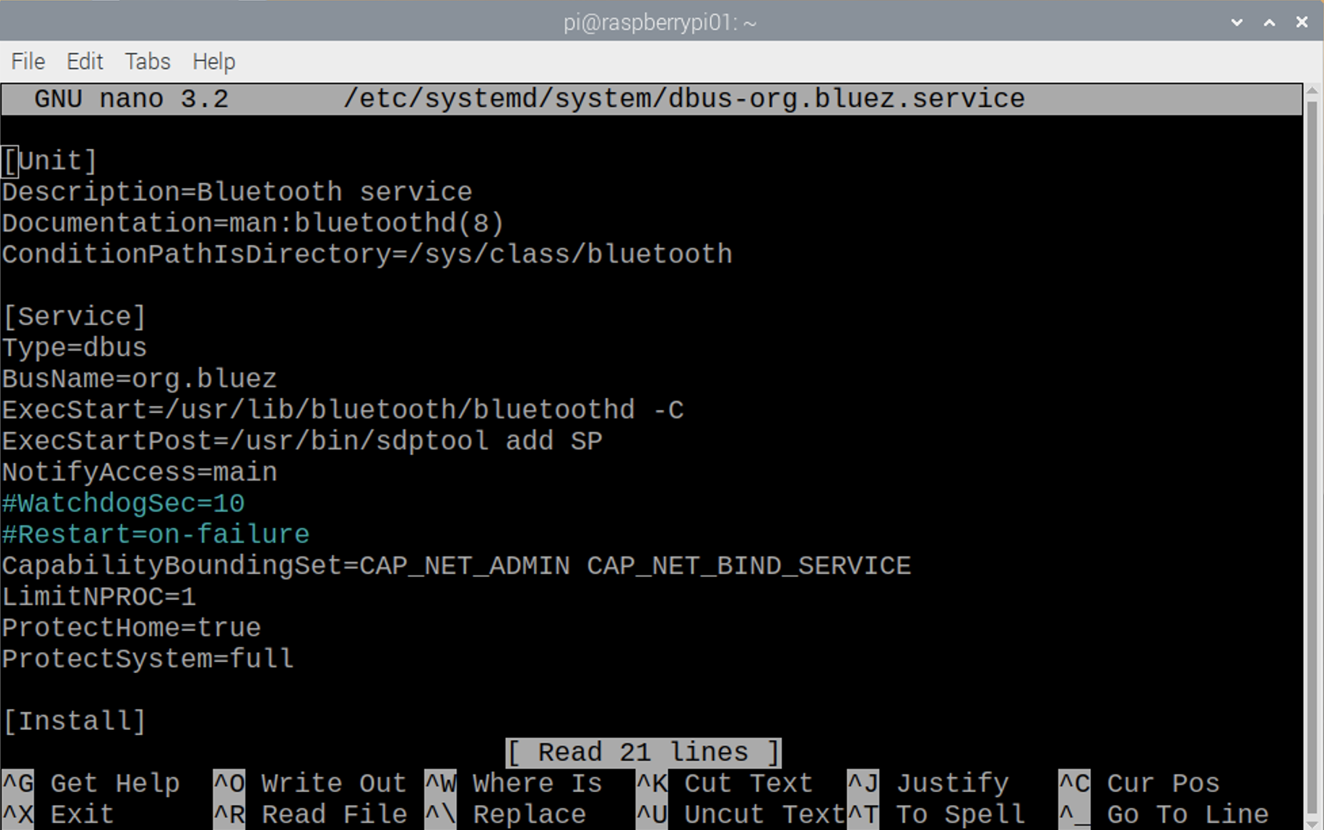
Python Program - Bluetooth setup
$ sudo nano /etc/systemd/system/dbus-org.bluez.service

Slide 7
Python Program - Bluetooth setup
Add -C at the end of the ExecStart = line.
Also add another line after the ExecStart line.
The final two lines should look like below:
ExecStart=/usr/lib/bluetooth/bluetoothd -C
ExecStartPost=/usr/bin/sdptool add SP

Slide 8
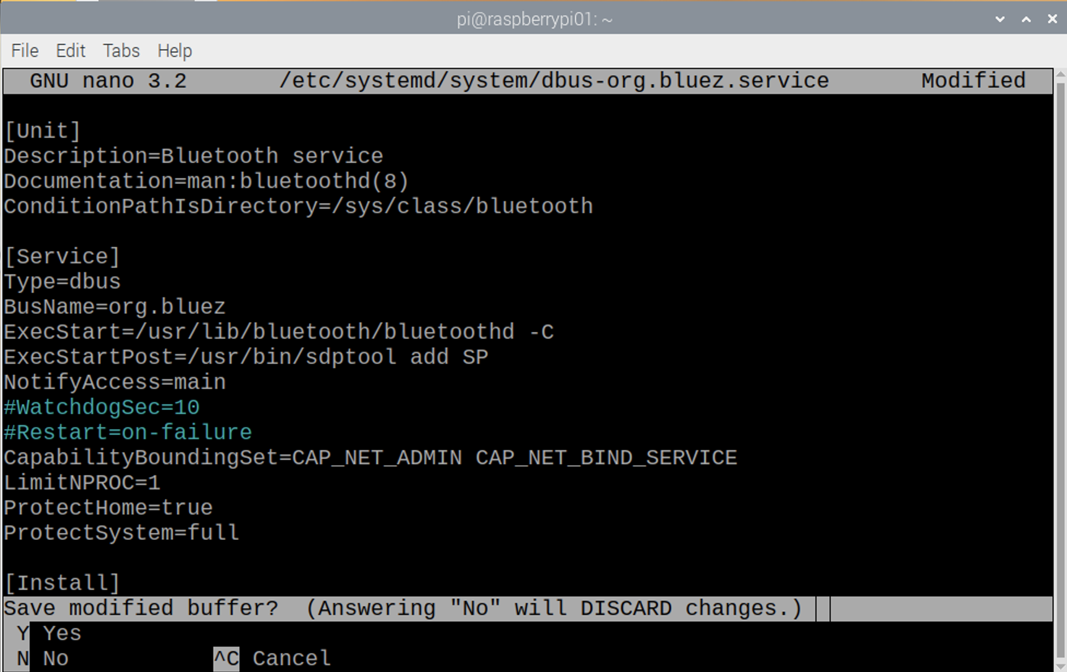
Python Program - Bluetooth setup
Exit and save the file by entering Ctrl + X, followed by Y.
Press enter after type in Y

Slide 9
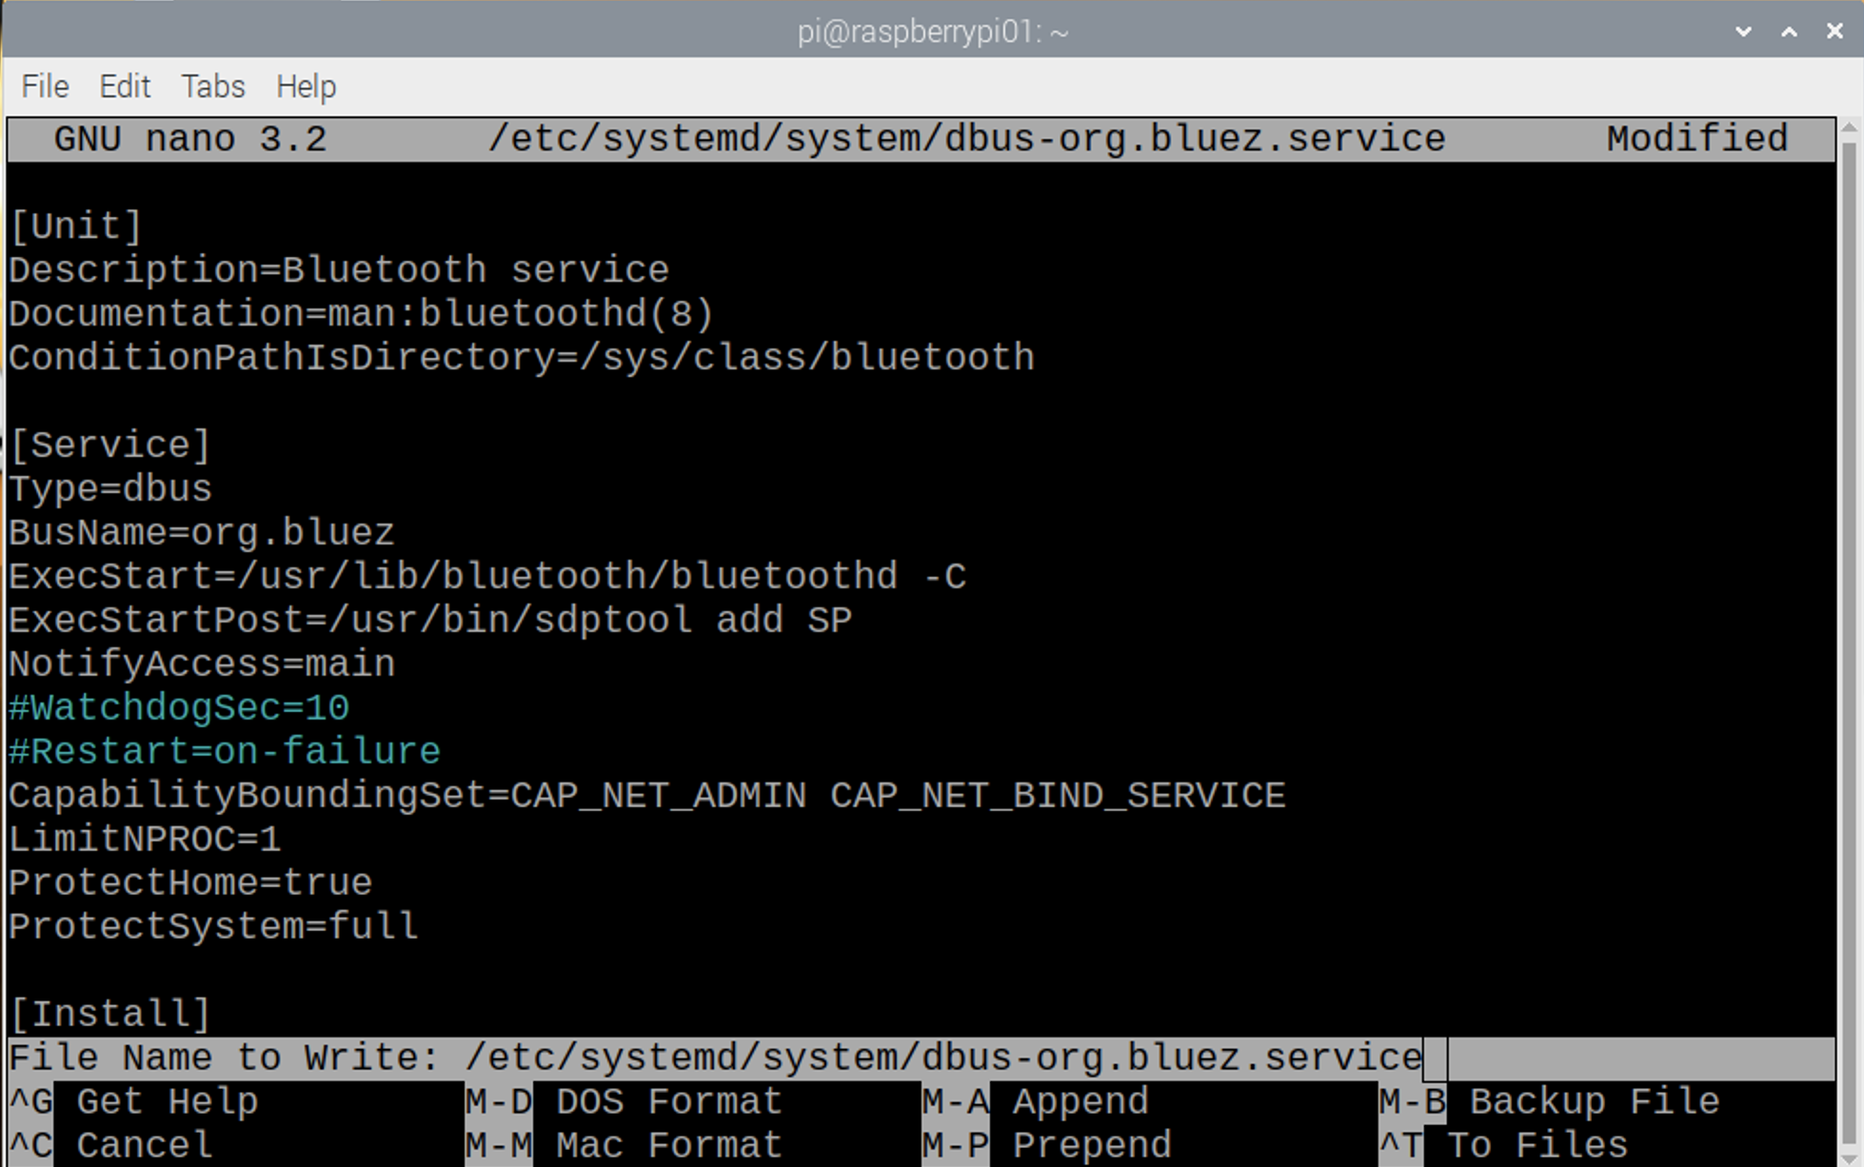
Python Program - Bluetooth setup
Exit and save the file by entering Ctrl + X, followed by Y.
Press enter after type in Y, you will be back to terminal screen

Slide 10
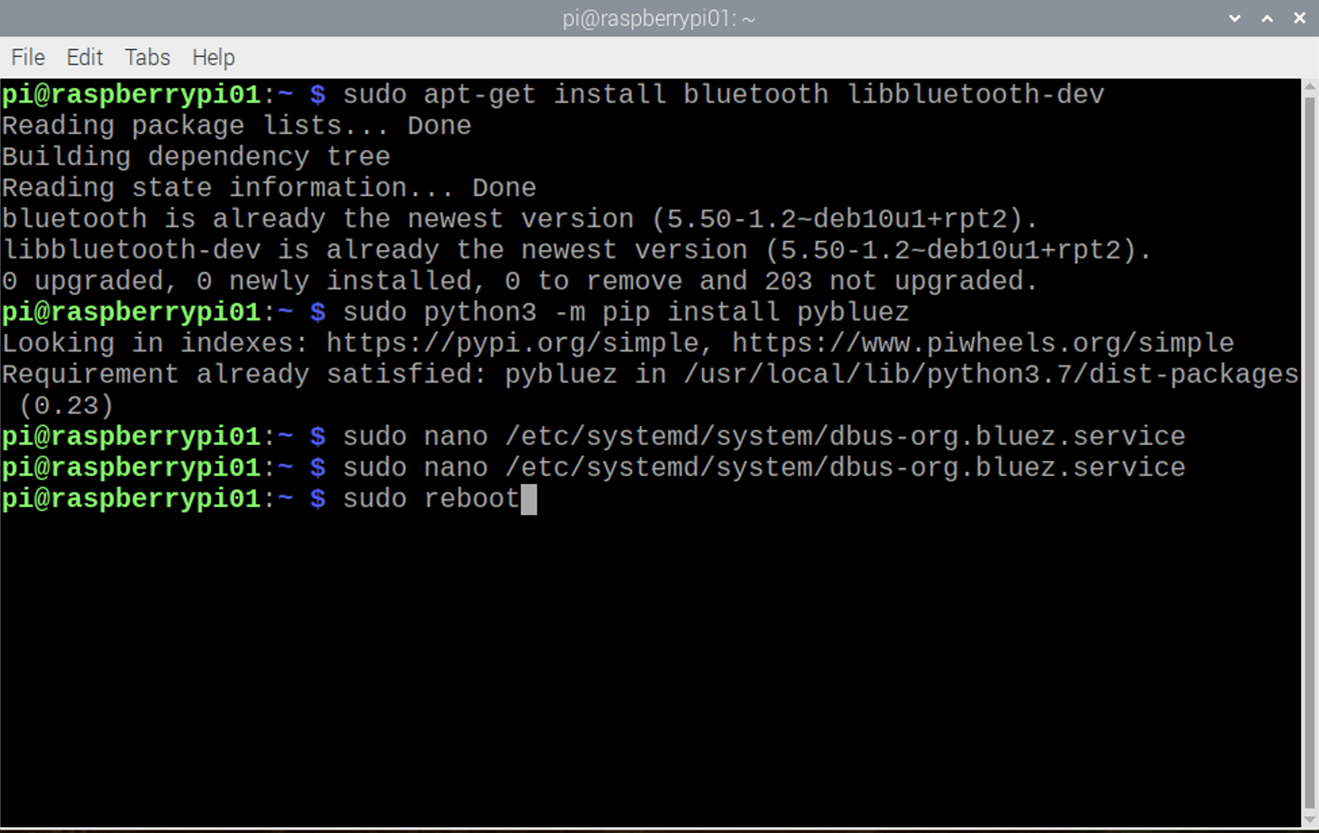
Python Program - Bluetooth setup
$ sudo reboot
Press enter, your Raspberry Pi will reboot

Slide 11
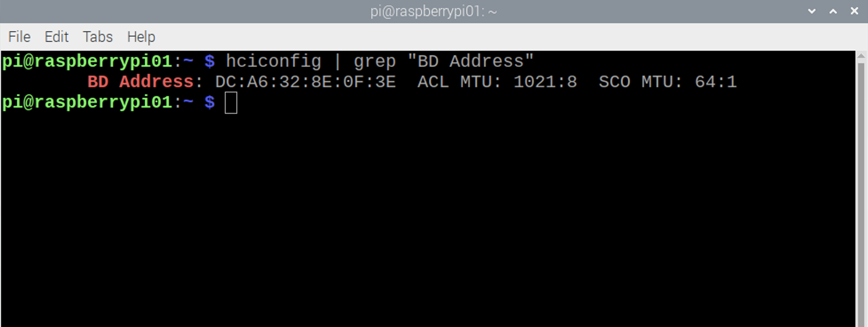
Bluetooth Pairing with Android Devices
Open your terminal, type below command:
$ hciconfig | grep "BD Address”

Slide 12
Bluetooth Pairing with Android Devices
MAC address: A media access control address (MAC address) is a unique identifier assigned to a network interface controller (NIC) for use as a network address in communications within a network segment. This use is common in most IEEE 802 networking technologies, including Ethernet, Wi-Fi, and Bluetooth.

Slide 13
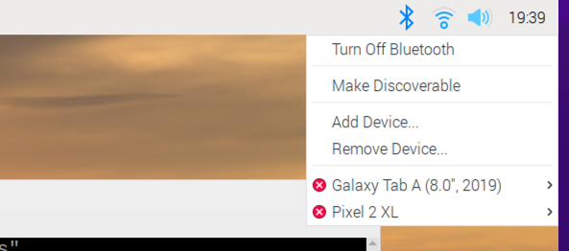
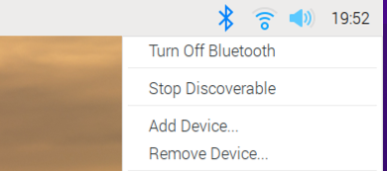
Bluetooth Pairing with Android Devices
Config your raspberry Pi to discoverable.
First make sure the bluetooth is turned on, then click on Make Discoverable, you should see the bluetooth icon is flashing in green and blue color.

Slide 14

Bluetooth Pairing with Android Devices
Go to your Android device, find connection under settings.
Pair raspberry pi with your device.

Slide 15
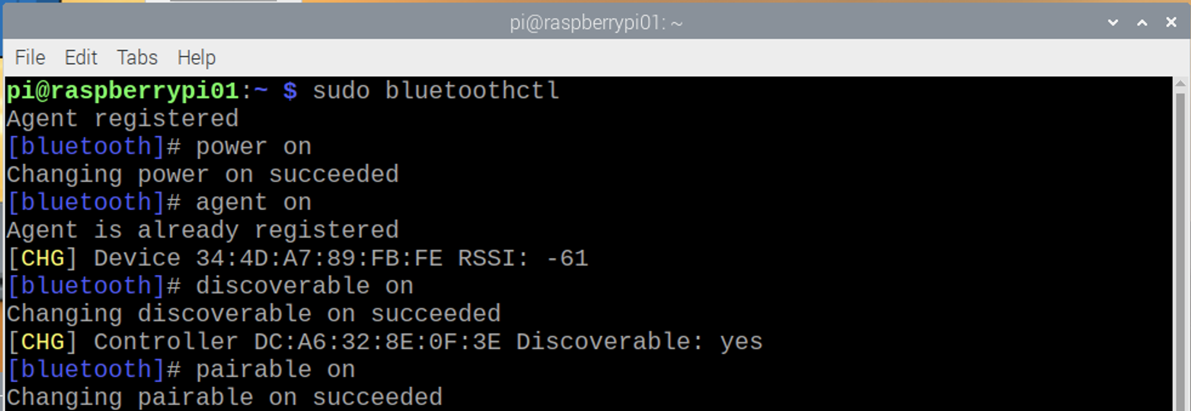
Bluetooth Pairing with Android Devices
Debug from terminal.
$ sudo bluetoothctl
# power on
# agent on
# discoverable on
# pairable on

Slide 16
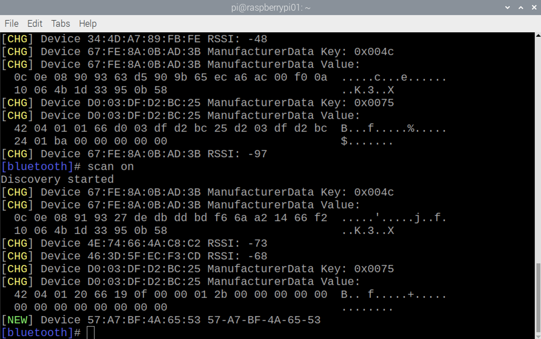
Bluetooth Pairing with Android Devices
# scan on
After the last command “scan on”, you will see your Bluetooth device (Mobile phone) in the list. Make sure that your mobile has Bluetooth turned on and visible by nearby devices. Then copy the MAC address of you device and pair it by using given command:
# pair <address of your phone>

Slide 17
Python Program - LED control through bluetooth
Decode MAC to ASCII (utf-8 in python 3)
#--------------------------------------
#
# decode Pi signal/data
#
#--------------------------------------
try:
while True:
data = client.recv(1024) # Recieve data bytes
if data.decode('utf-8') == '1': # 1 received
GPIO.output(LED, 1) # LED ON
elif data.decode('utf-8') == '0': # 0 received
GPIO.output(LED, 0) # LED OFF
except KeyboardInterrupt: # Keyboard interrupt
client.close()
s.close()
Notice that what is returned into variable data is byte objects which is actually arrays of integers.
Here, we are using the built-in decode function to convert them into their equivalent ASCII characters.
In Python3, utf-8 is the default encoding and decoding parameter.

Slide 18
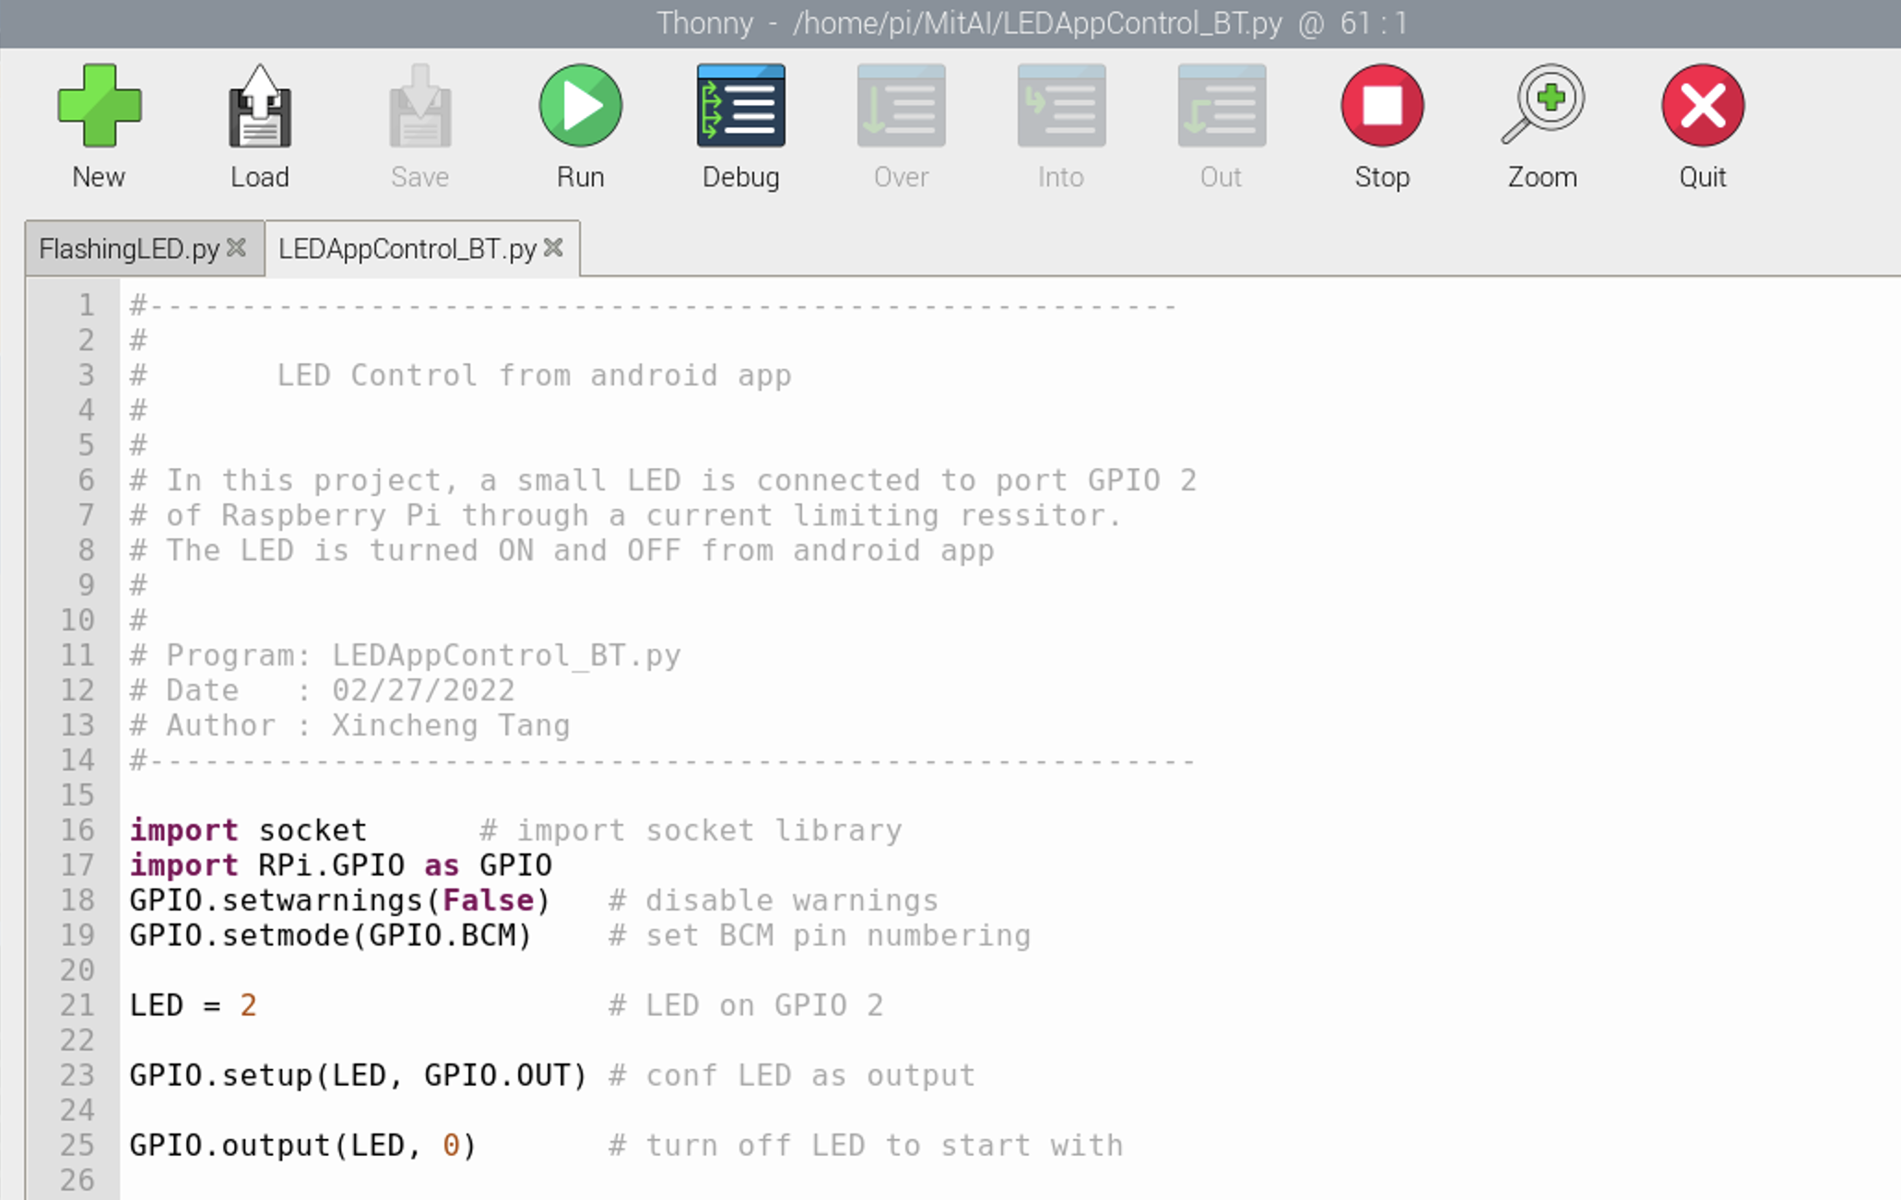
Python Program - LED control through bluetooth
Develop the python program to for bluetooth control.
GPIO library setup

Slide 19
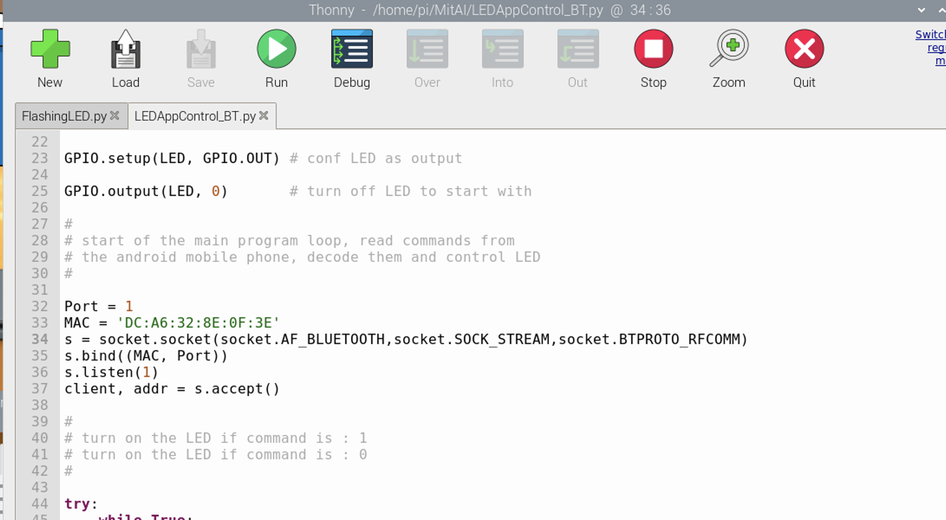
Python Program - LED control through bluetooth
Setup socket to recieve signal from physical device.

Slide 20
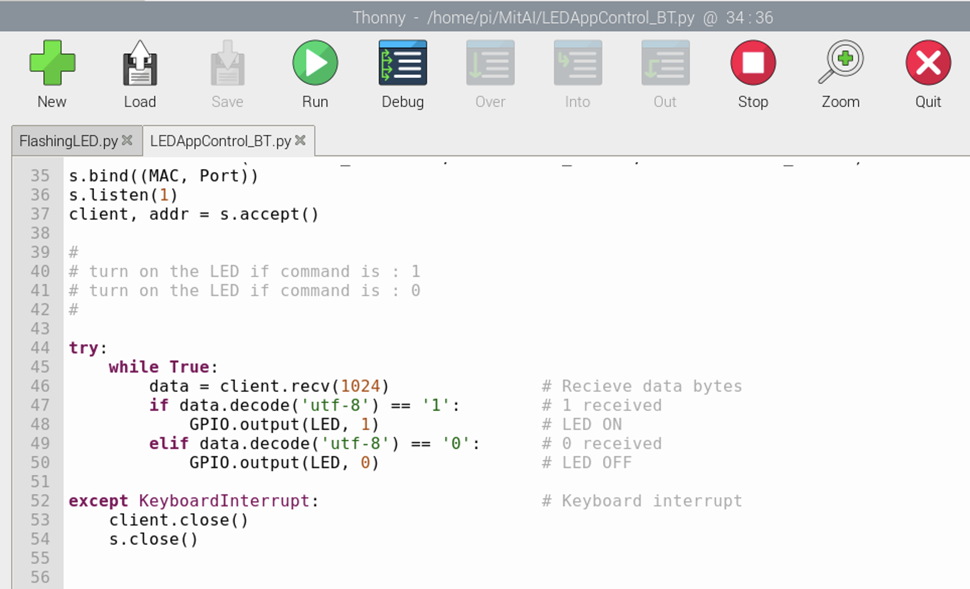
Python Program - LED control through bluetooth
Decode the signal.

Slide 21
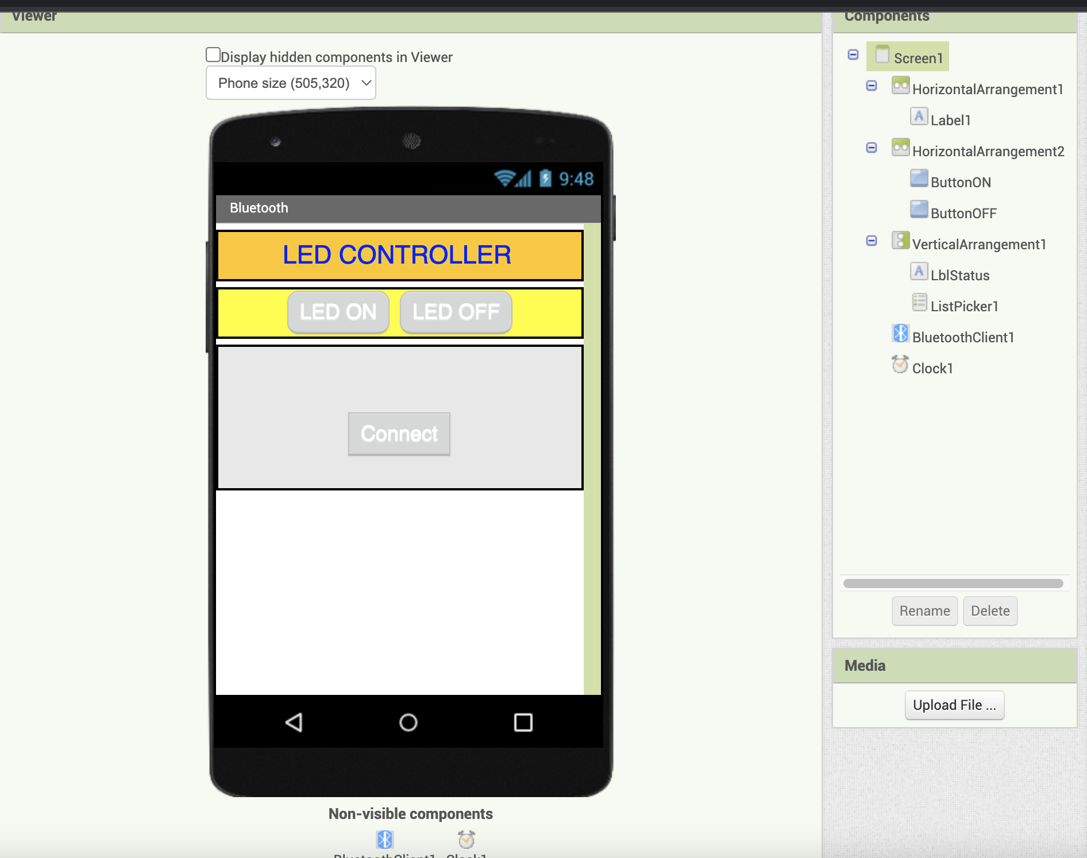
App Inventor - LED control through bluetooth
Application designer build.

Slide 22
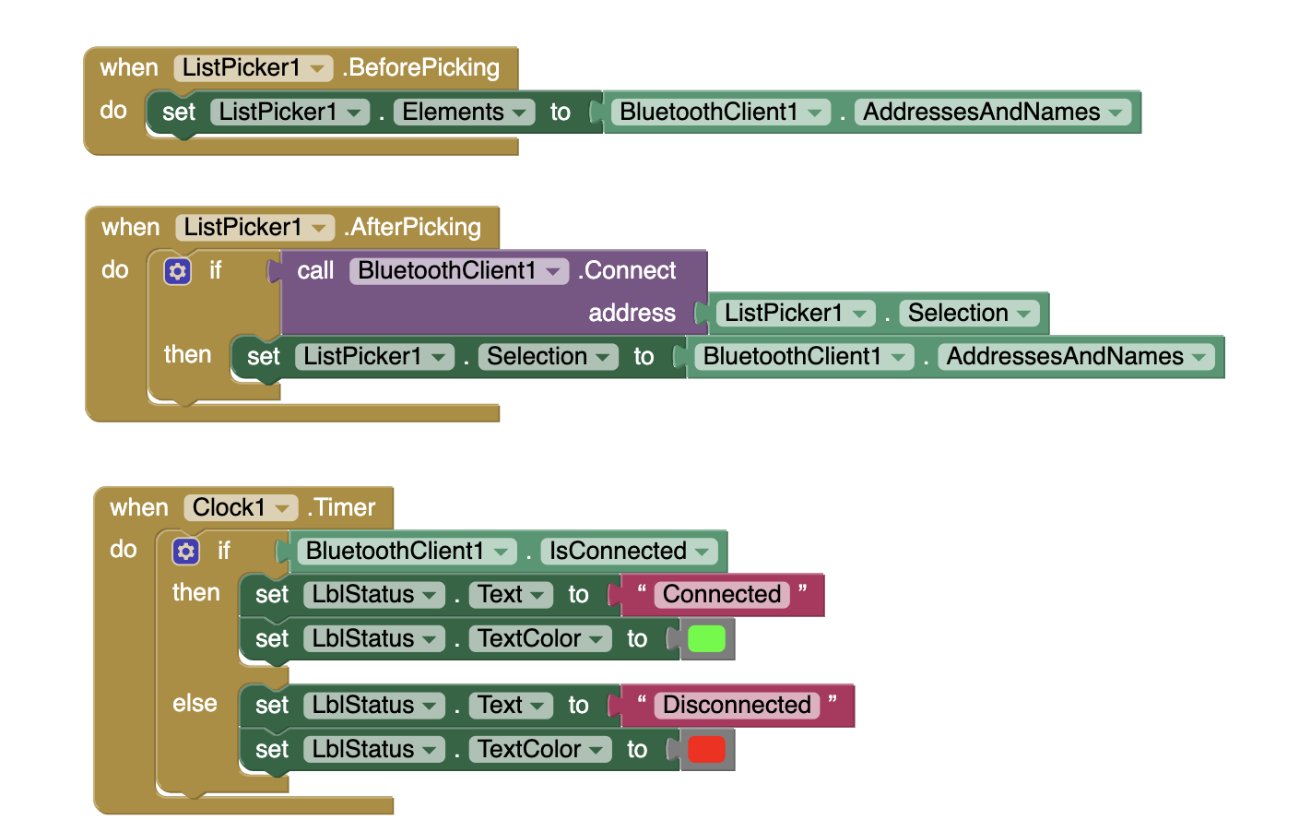
App Inventor - LED control through bluetooth
Application blocks build.

Slide 23
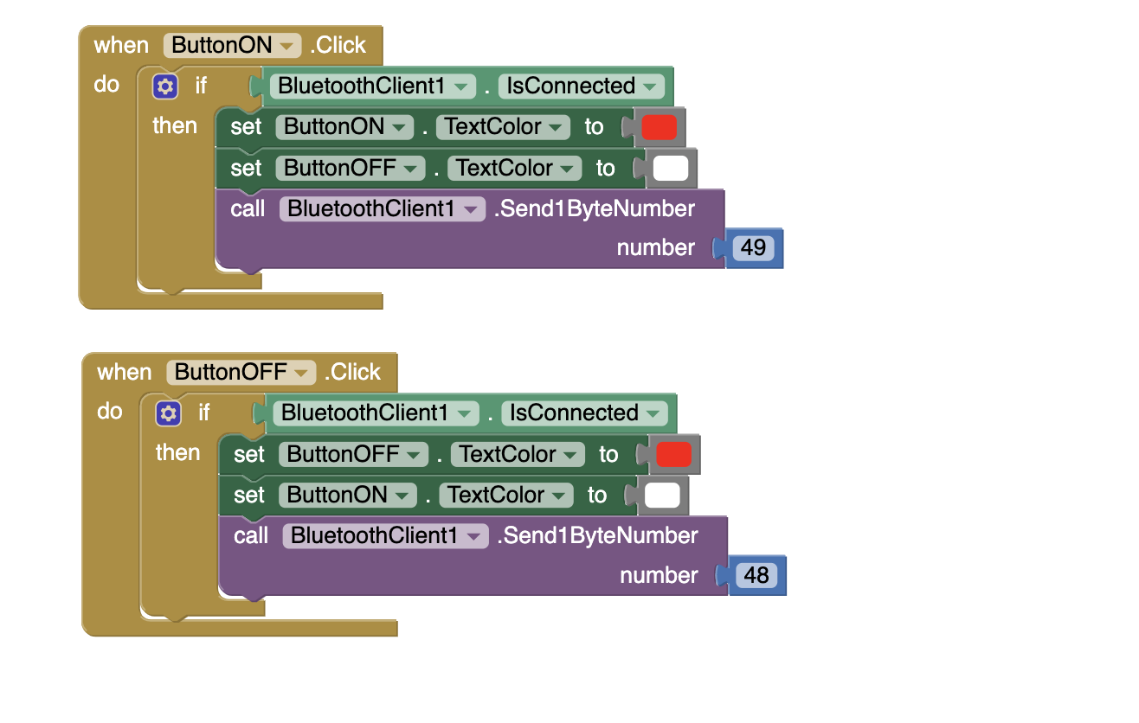
App Inventor - LED control through bluetooth
Application blocks build.

Slide 24
App Inventor - LED control through bluetooth
Application blocks build.

Slide 25
LED Control App - Bluetooth
Test steps:
Make sure that Bluetooth is enabled on your Android device.
Make Bluetooth discoverable by clicking the Bluetooth icon on the top right-hand side of your raspberry Pi.
You may have to accept to pair the two Bluetooth devices. If it asks for a password, enter 1234.
Run your python program from GUI.

Slide 26
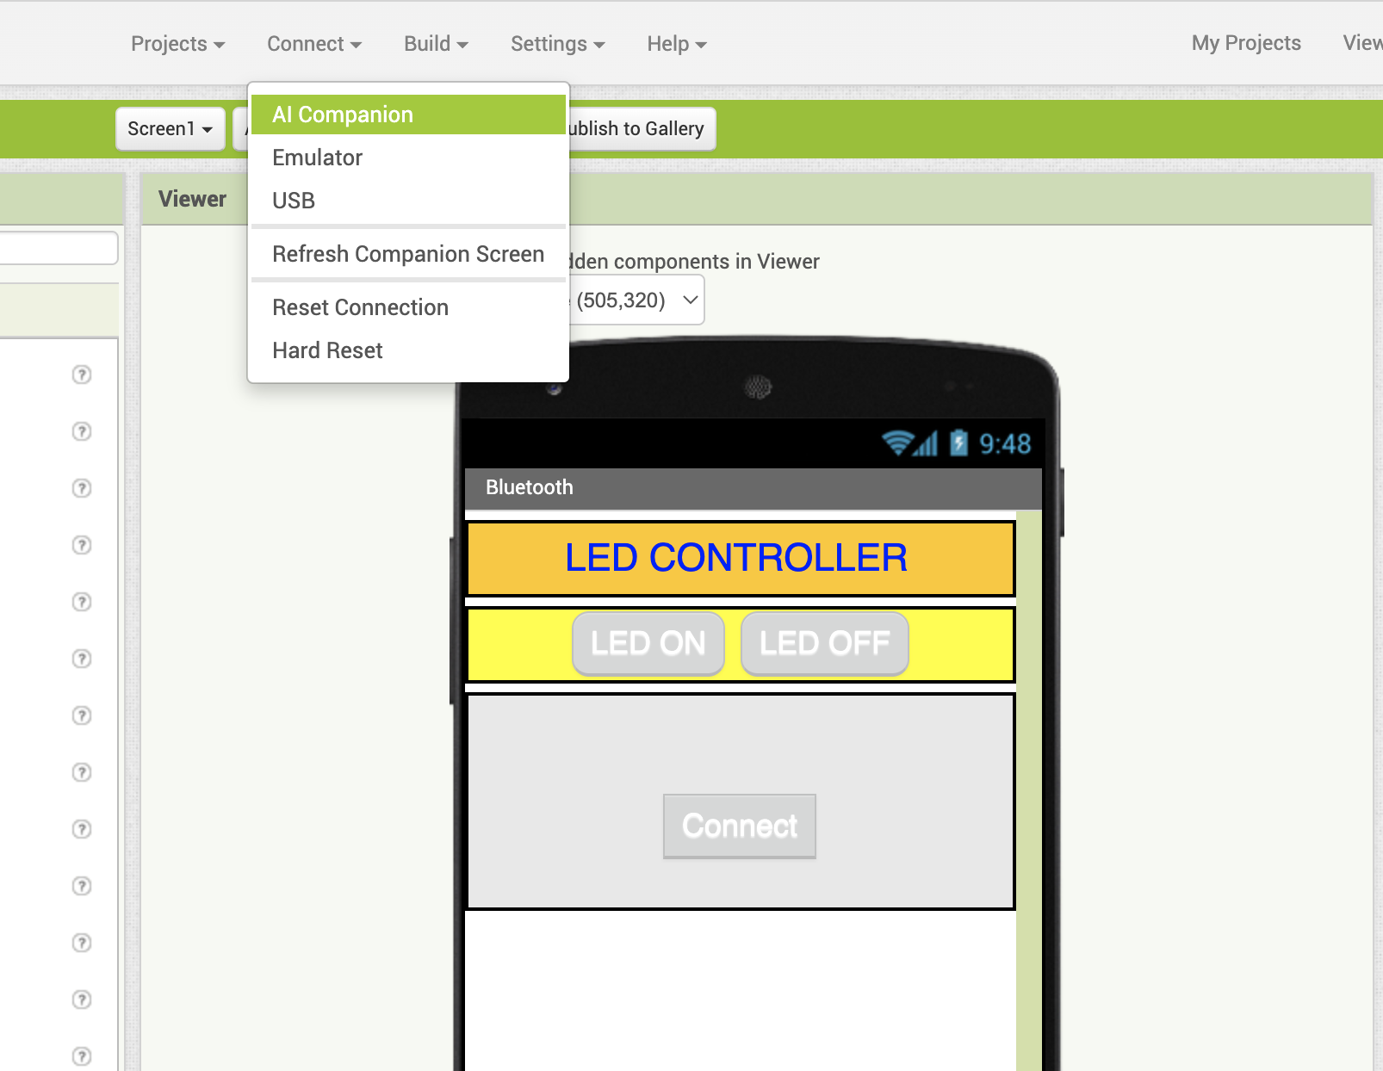
LED Control App - Bluetooth
Test steps - continued :
Generate QR code through AI companion, and scan from your android device.

Slide 27
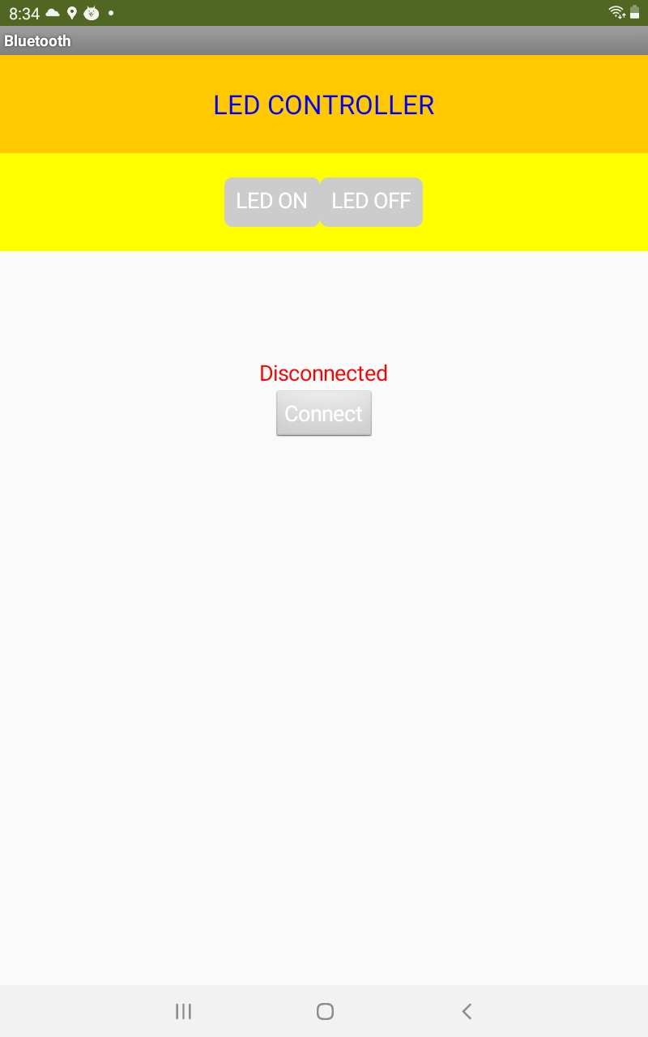
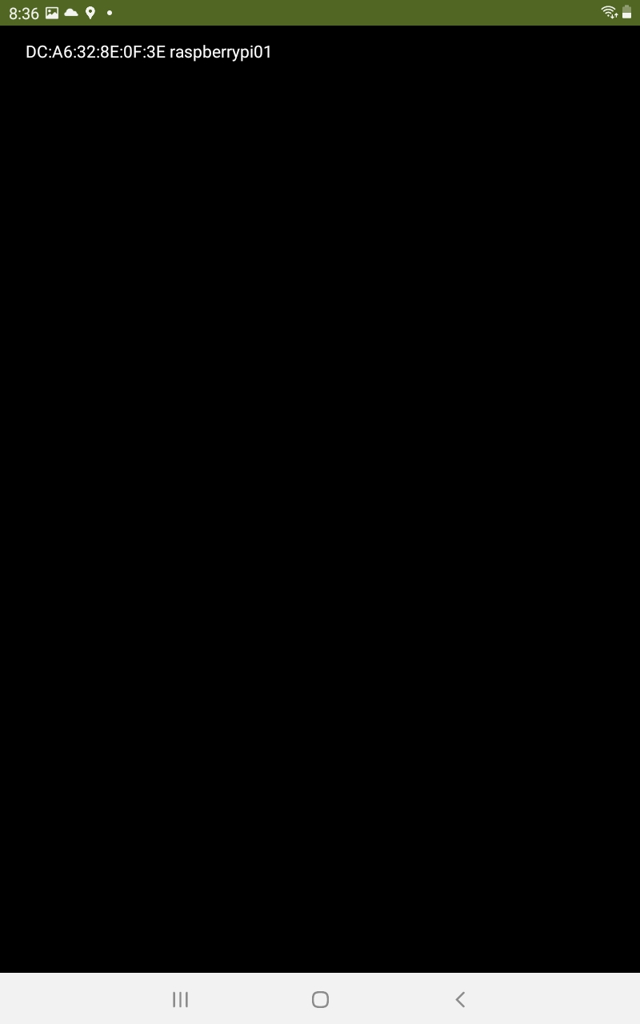
LED Control App - Bluetooth
Test steps - continued :
Start the mobile application on your Android device and click button Connect.
You should see the reachable bluetooth devices, click on raspberry Pi.

Slide 28
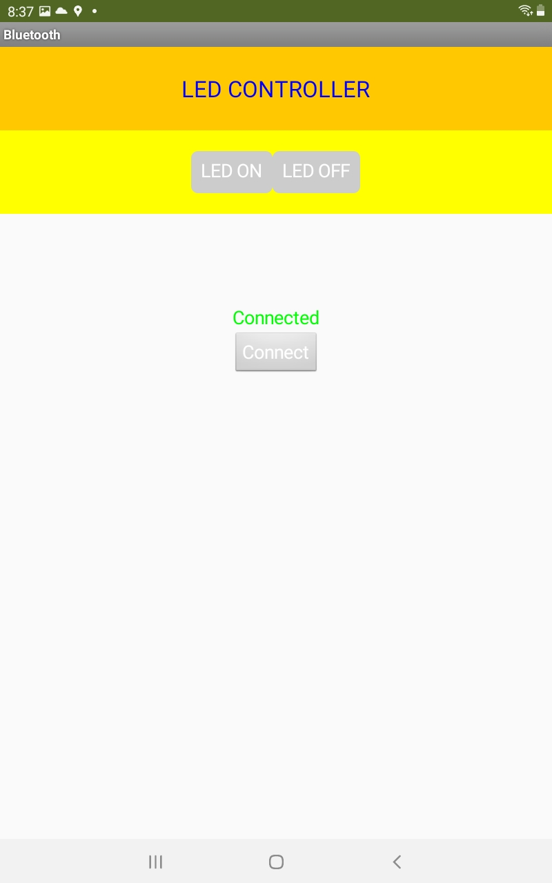
LED Control App - Bluetooth
Test steps - continued :
After click on raspberryPi, your app will show Connected!
Now you can test your application.

Slide 29
Python Program - LED control through bluetooth
Home project - Develop app to control LED through speech commands

Slide 30
IoT with MIT App Inventor
Office hour

